Slide 1

Challenge
How can we use technology or new ideas to improve the Aker Brygge Experience?
How can we use technology or new ideas to improve the Aker Brygge Experience?

Slide 2
Saghar Asadi, Erwin Ried, Marko Ikonomovic, Amanalla Kashgari, Jan-Are Paulsen (CBRE)
Team JAMES

Slide 3
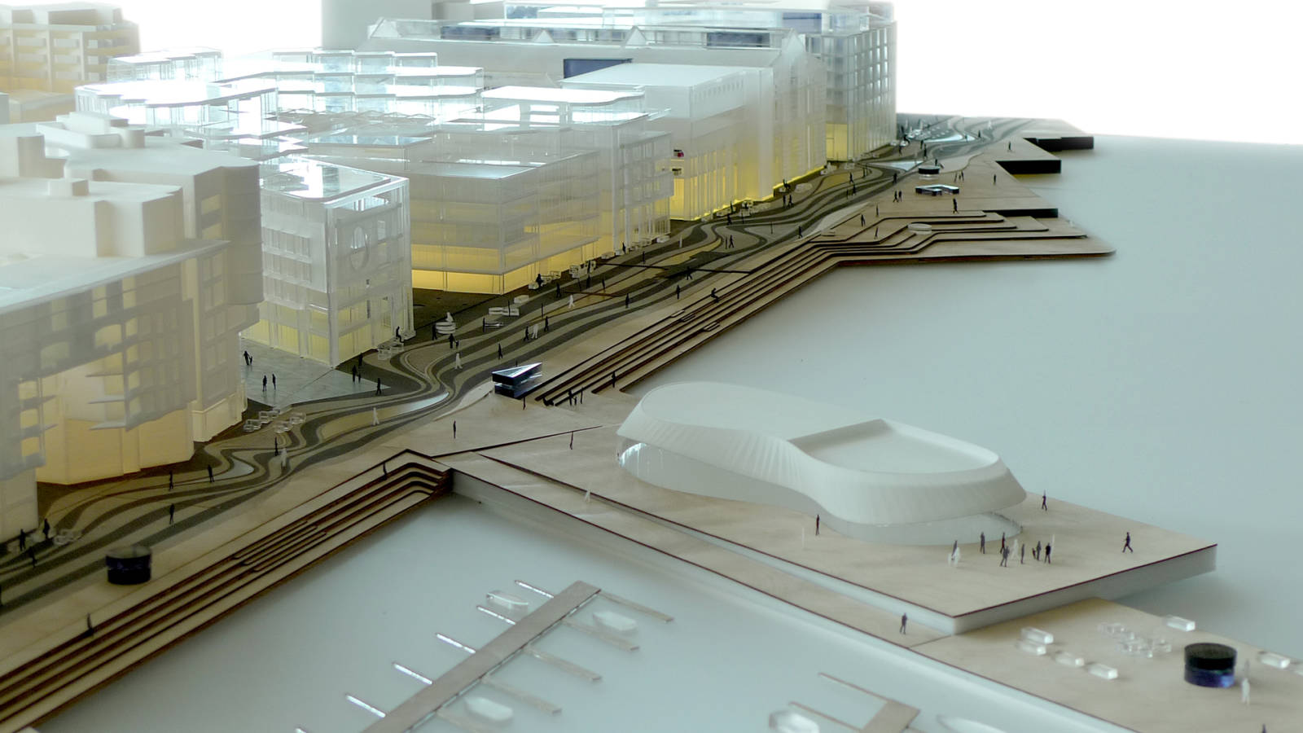
Residents + workers = 7000
70 shops + 40 restaurants/bars = 7500 chairs (2500 outdoor)
1 cinema
1 garage = 900 cars
1 guests harbor = 125 boars
2million visitors

Slide 4




Community
Decision Makers
Residents, office workers
Local visitors and tourists
Shops, hotels, restaurants and cafes
Aker Brygge
Norwegian Property
Oslo municipality

Slide 5
Problem Statements
What are we solving
Local visitors and tourists
Offers
Happenings
Local businesses
Offers
Events
News
Property owners
Added services
Exclusivity
Notes:
Local visitors and tourists need a way to obtain local information regarding offers, events, happenings in the Aker Brygge area because local information is hard to find and they do not know about current events.
Local businesses need a way to convey information about offers and news they have to the end users because the lack of interactive digital platform.
Property owners need a way to provide value added services to the tenants/visitors because of the prestige association with the location, symbol of innovation to build a true interactive community.

Slide 6

An interactive product which enhances sense of community for the locals and visitors via modern connections.

Slide 7
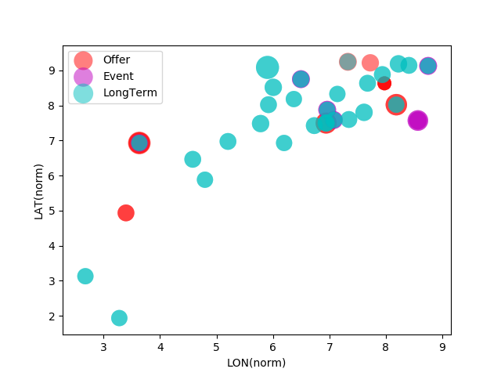
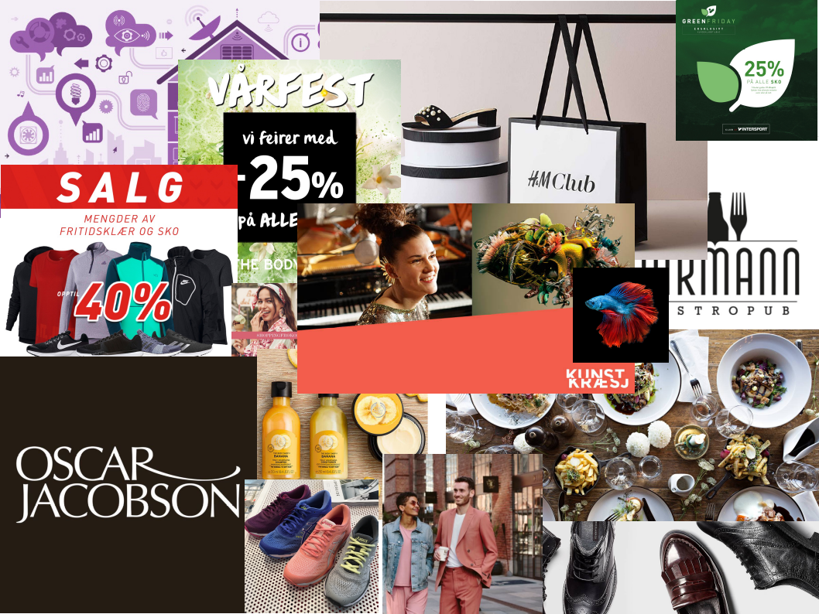
Functionality
Campaigns ending within a month from june 1st
WHERE
WHAT
Size: days left

Slide 8
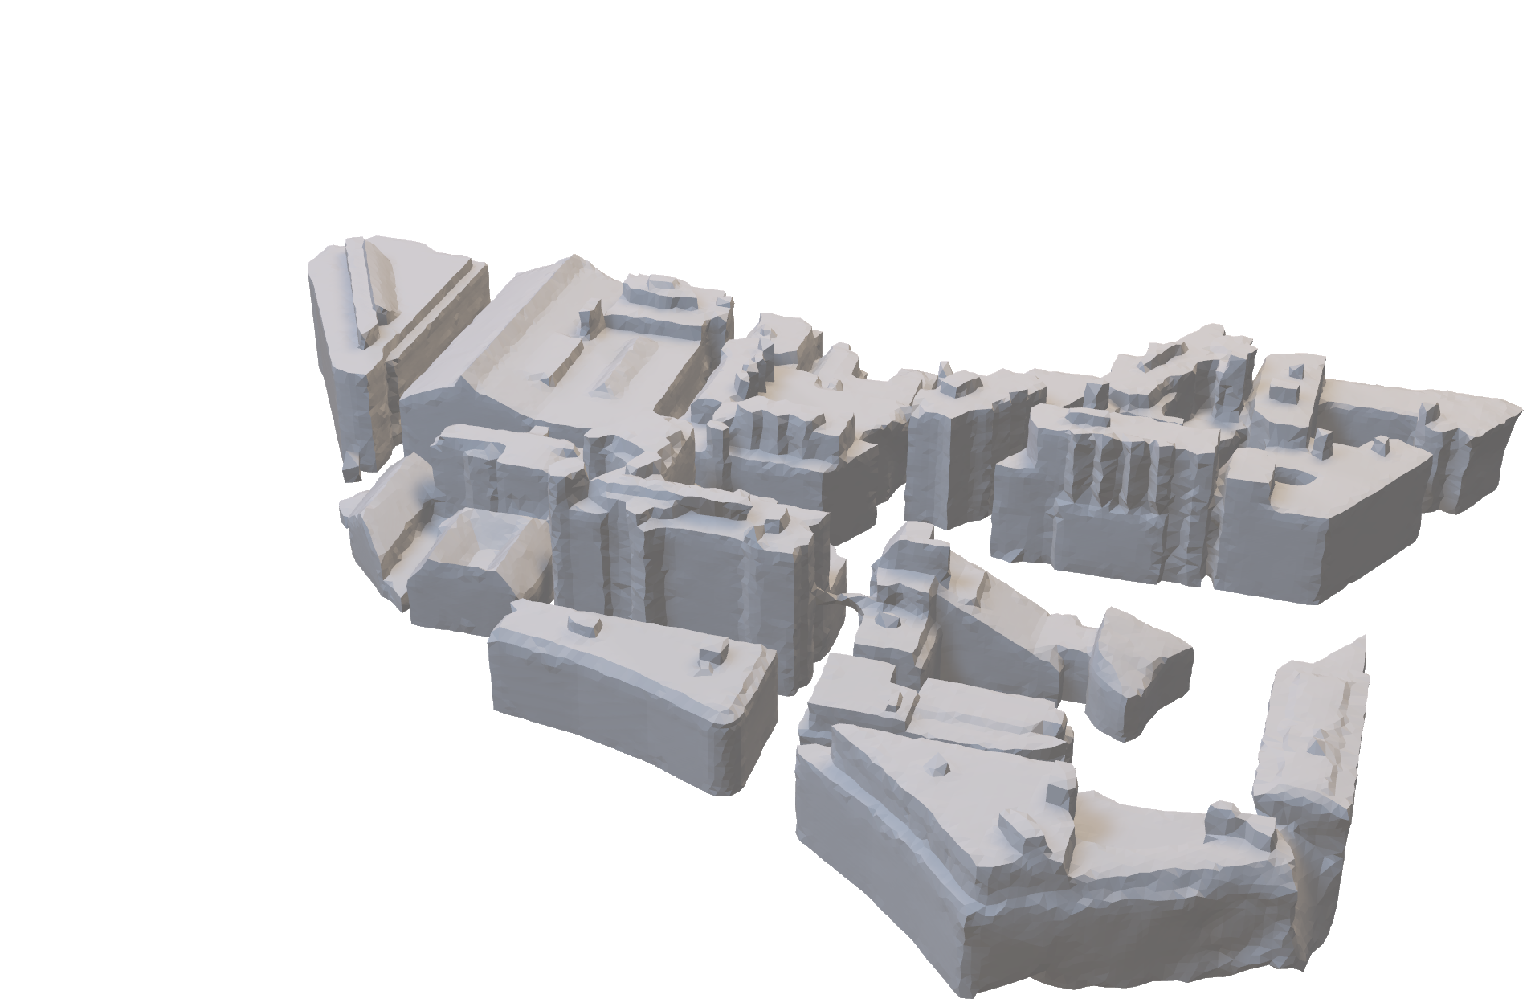
The Product

Slide 9
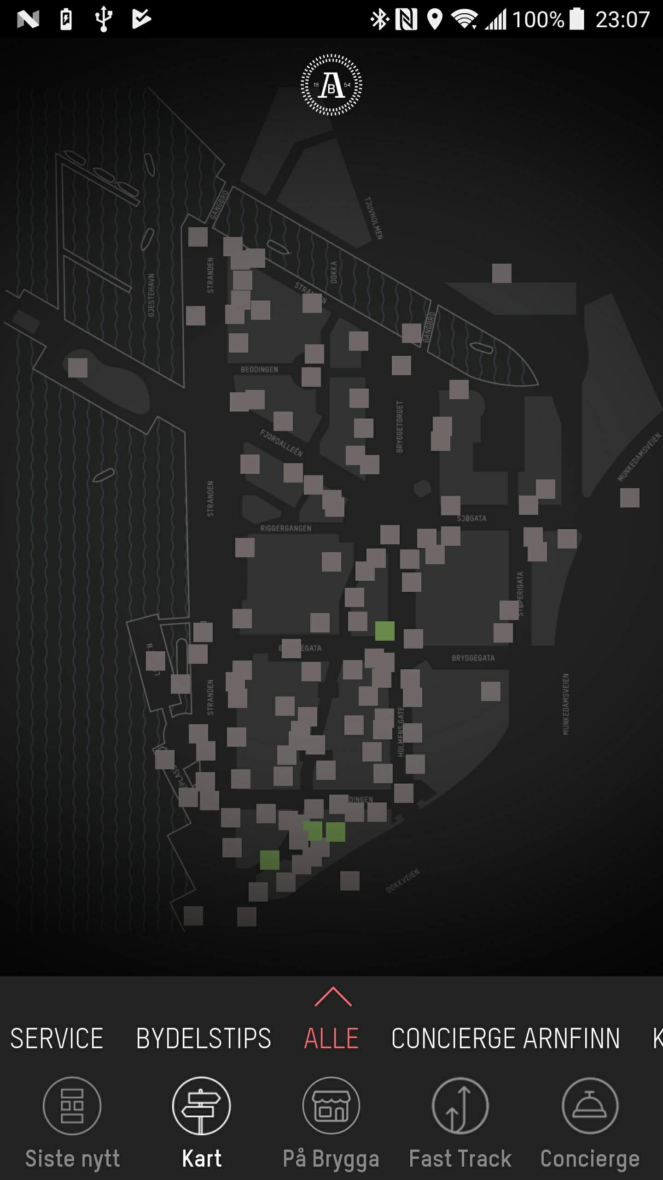
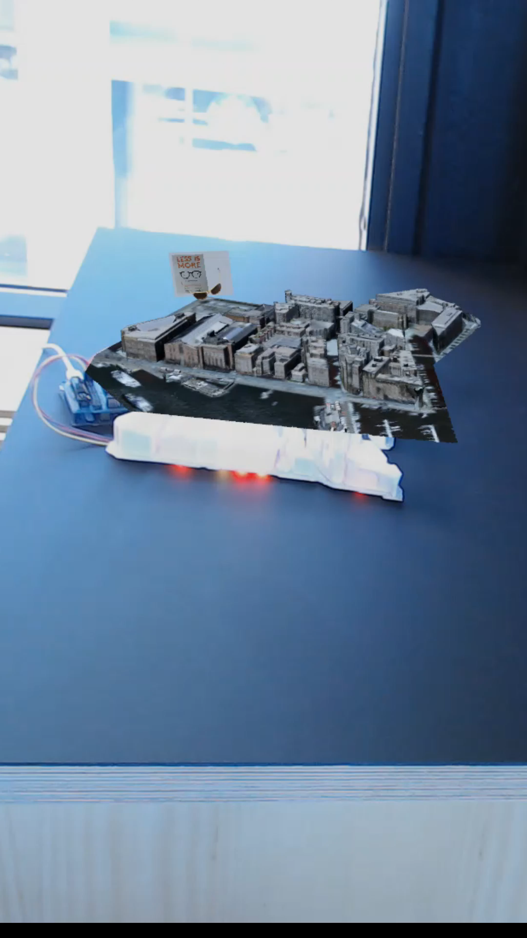
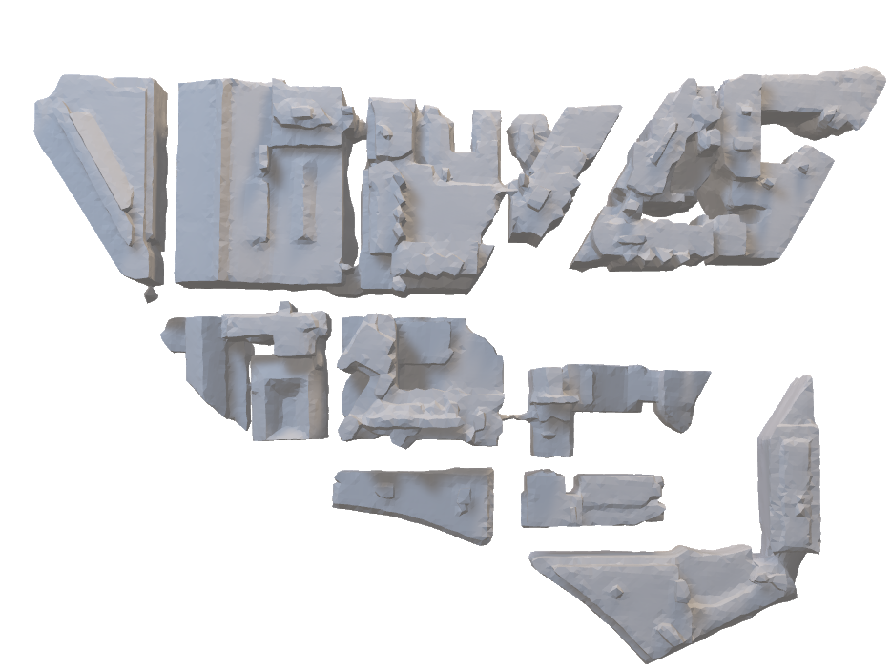
The Product
BRILLER
Kart&AR

Slide 10
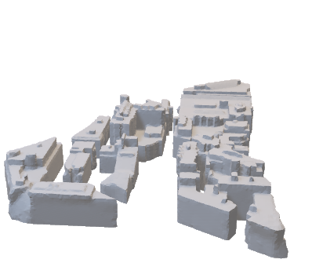
Prototype specifications
Current
 | Proof of concept | Final proto
Physical model | Google 3d view + 3DF Zephyr (photogrammetry) | Real drone 3d scan (permit required) + manual tuning + 3DF Zephyr + AWS S3 Windows GRID GPU
Source | .csv file with 2018’s campaign activities/locations | Aker Brygge’s REST API
Server | Python + serial connection | Python/Joomla backend + REST API
Hardware | Arduino + WS2811 NeoPixel strips | ESP8622 IoT device + WS2811 NeoPixel matrix
Firmware | AVR C/C++ | C/C++

Slide 11
Features
Futures
Displays offers, events, directions
AR provides details and coupons
Symbol of innovation, interactive platform, digital twin technology
Safety: fire, gas, threat alerts
Traffic: flow of foot activity and density
Natural phenomena: weather, aurora, sun, constellations
Solidarity and celebrations

Slide 12
Revenue Model
Innovation Garage
Aker Brygge
Tenants
Notes:
Over all, we have conducted interviews with over 35 individuals consists of dock workers, office workers, business owners, visitors, and tourists to obtain insights. At the end, 15 interviewees stated there is 100% need for such product/services to improve their experience.

Slide 13
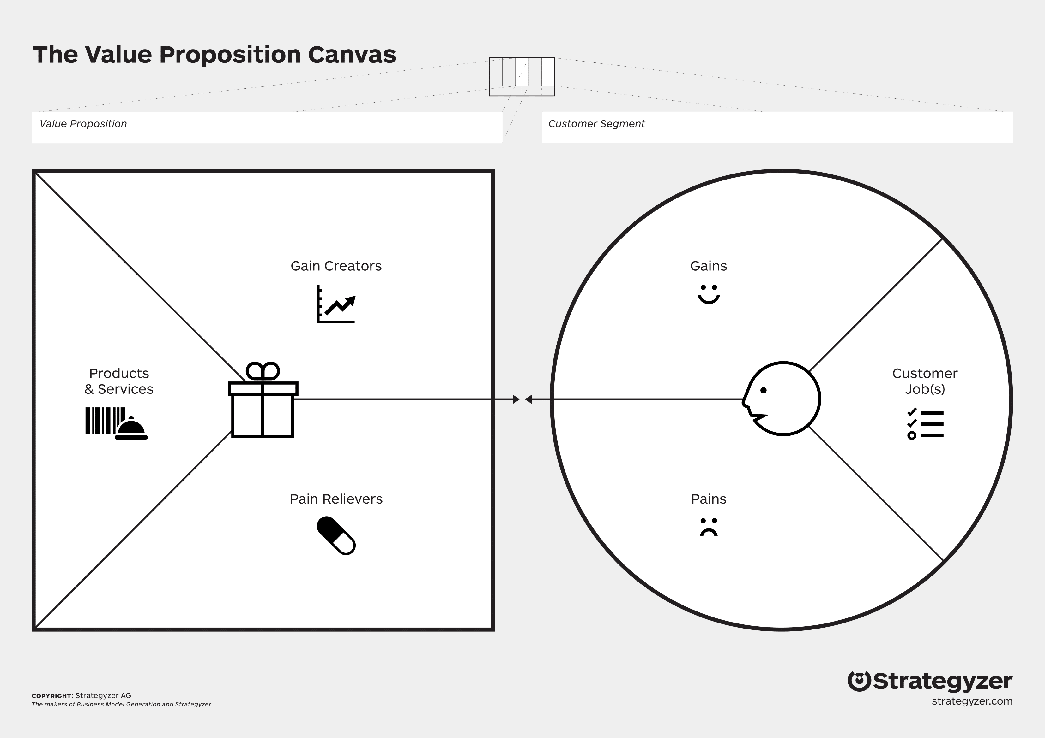
High middle class and visitors
Artistic visual update
Community for residents and tenants
Interactive platform
Digital Twin Technology
Friendly marketing
Local information
Modern Innovation
Creative engagement
Symbol of Innovation
More local information
Prestige association with the location
Updates of local activities
New platform of marketing
iAker Brygge
New activities
Sense of community
Provide updates
Lack of activities
Lack of musician & Artists
Sense of belonging
What is new?
Rewards of being at Aker Brygee
Exclusiveness
Guidance
Didn’t know about events
Sense of Order
Hard to find places
Local deals
People like to show off
Too much going on
Night life ☹

Slide 14
Thank you

